Slide 1
UT Phased Array inspection for Aircraft turbine discs
Perform your inspection with an added value.

Slide 2
Summary
Presentation of FAAST technology
Turbine UT inspection with Multi-angle
Turbine UT inspection with Multi-focus
Reference’s Introduction
Example of A-Scans
Results Analysis
Get a feasability study on your products with Socomate
Advantages and conclusion

Slide 3
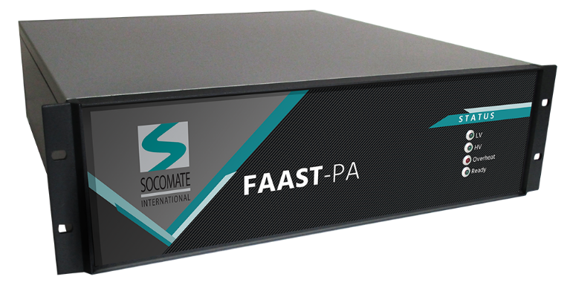
Presentation of FAAST technology
FAAST-PA is a Phased Array system much more powerful than standard ones. Due to its capacity, it provides high productivity for UT testing lines, with high flexibility.
The product is coming with a full Software Development Kit to supply high possibility regarding application Software.
All parameters, such angles, are configurable through Software settings and is as easy to use as standard product, the only difference is; All beams are generated simultenaously.
Certified ISO 18563-1 according to Phased Array standard
Capabilities presented:
Multi-angle: Transmit multiple oriented beams in 1 single shot with real time data processing
Multi-focus: Transmit multiple focused beams in 1 single shot with real time data processing

Slide 4
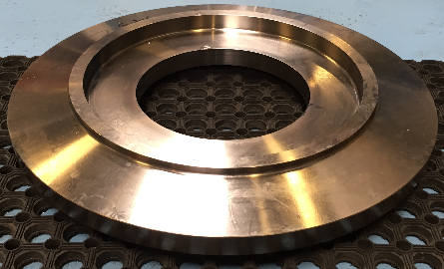
UT turbine discs inspection using Multi-angle
Standard Inspection
Multi-angle inspection for e.g 0°and ± 5°
UT FAAST Phased Array Multi-angle
PA Probe
+
PA (or Conventional) Probe
Standard Inspection: Several inspection runs are needed, according to the required angles. 3 inspections would be necessary to perform the fully control
UT FAAST Inspection: ONE SHOT is required for multiple angles using only 1 PA probe, allowing thus to increase the inspection speed. For example, such configuration is 3 times faster than with standard Phased Array inspection.
+

Slide 5
UT turbine discs inspection using Multi-focus
Standard Inspection
Multi-focus inspection for Multizone testing
UT FAAST Phased Array Multi-angle
PA Probe
Shot 1
Shot 1
+
PA (or Conventional) Probe
Standard Inspection: Several inspection runs are needed, according to the required focused depth. 3 inspections would be necessary to perform the fully control
UT FAAST Inspection: ONE SHOT is required for multiple focused using only 1 PA probe, allowing thus to increase the inspection speed. For example, such configuration is 3 times faster than with standard Phased Array inspection.
Shot 2
+
Shot 3

Slide 6
Reference’s Introduction using FAAST technology
Performances does not mean a decrease in Quality.

Slide 7
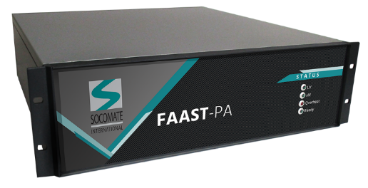
Reference’s Introduction
The specification were to inspect a complex turbine disc, for Aircraft industry, using Phased Array technology.
Due to its complexity, the turbine has been divided in 7 zones, which should lead to 7 sequential shots with conventional Phased Array
The turbine has been made with Titanium, going up to 139,7mm.
The objective were to detect Ø0, FBH from 2,5mm up to 139,7mm and using only 1 PA probe.
FAAST technology is able to perform the complete inspection within a maximum of 3 shots, instead of 7 using only 1 PA probe, and at equivalent rotation’s speed. The full shaft testing is made within 1 pass.

Slide 8
Example of A-Scans
0,4mm FBH at 2,5mm from the surface
0,4mm FBH at 139,7mm
SNR=21dB
No Defect
No Defect

Slide 9
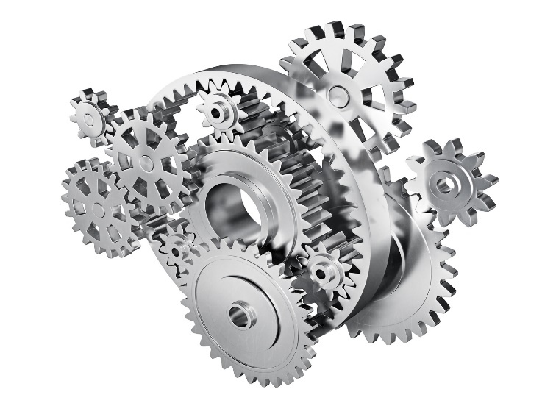
Results Analysis
Analysis of above examples:
When multiple angles are required, or several focus depth for multizone testing procedures, FAAST technology can deliver real advantages, in comparison to conventional Phased Array, in terms of speed, but not only, as it can be perceived as a very flexible system.
When Multi-angle is required, the FAAST can perform the same inspection within ONE single shot, allowing thus inspection speed advantages, without compromising the quality.
When Multi-focus is required for multizone inpection, the FAAST deliver real advantages in terms of inspection speed due to its capacity to emit several focused laws within ONE single shot, as well as in reception. Such capabilities allow the technology to supply high speed inspection with high quality results.

Slide 10
Get a feasability study
FAAST Technology allows high speed UT inspection, as well as lots of flexibility.
Used to equip new lines or retrofitting old electronics
Socomate International provides complete feasability study on your products.
(Number of required channels, Optimal probe, number of elements, sizes, shapes, frequency, …) following your requirements
Worldwide supplier of OEM UT electronics, coming with the most complete & friendly SDK, to customize your own application

Slide 11
Advantages and conclusion
High speed testing coming along with lots of flexibility
A performance that not decrease the quality
A team of experts at your service
Feasability studies on samples in Socomate’s laboratory, or on-site
Reducing the number of required probes and/or mechanics
Ideal for equipping new lines or retrofitting old electronics
Interested or having a project ? Contact us to have a more information
Thank you
Visit us : www.socomate.com
Sales contact : Xavier.harrich@socomate.fr

