Slide 1


UT system for Railway Inspection
Design your inspection vehicle with an added value.

Slide 2
Summary
Presentation of Phased Array FAAST, a patented Ultrasonic system
Illustration of a complete system
Presentation of the Acquisition computer
Presentation of the CrC measurement system
Configuration
References and examples

Slide 3
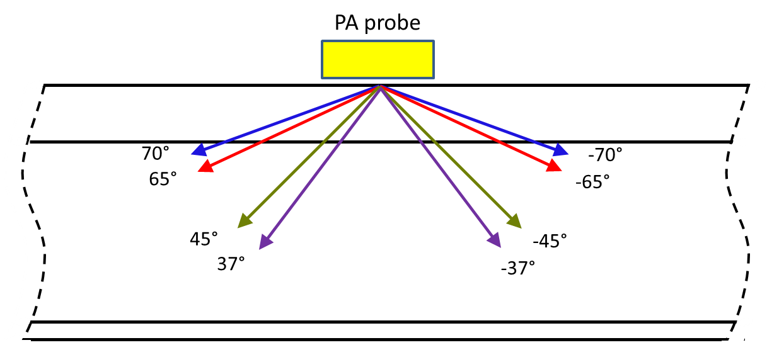
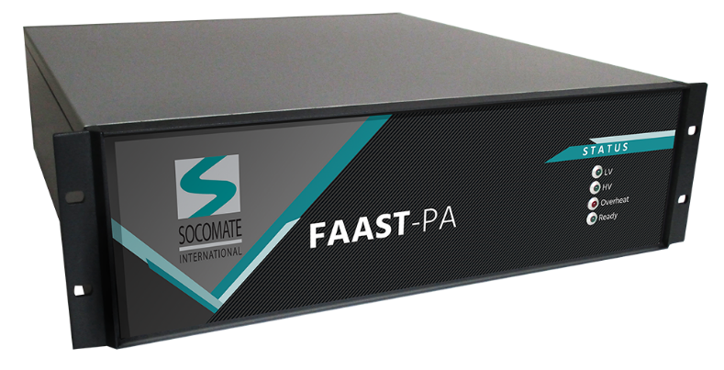
Phased Array FAAST for Railway application
Certified ISO 18563-1 according to Phased Array standard
Capacity to transmit multiple oriented beam simultenaously
Configuration of angles through Software settings
Inspection of :
Transvers cracks in the head
Longitudinal and Transversal flaws in the rail
Kidney shaped defects in the head
Star cracks from bolt holes
Cracks in the rail foot
Up to 16 directions simultenaously and processing signals in real time
Use of conventional probes for offset directions such as 0°, 55° and 70°
Supplied with DLL or with Acquisition Software and Measurement System

Slide 4
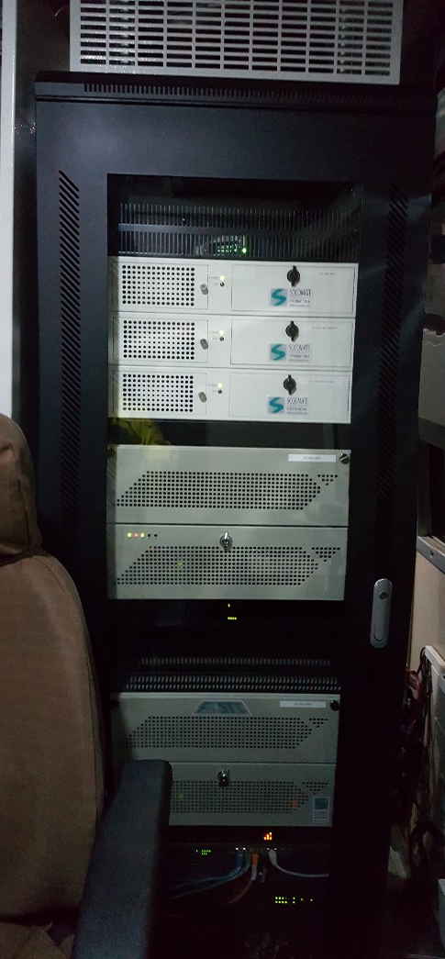
Illustration of a complete system
Real Time Report Computer with CrC Software(Supervisor)
Acquisition computer (Manage up to 16 channels)
Conventional UT electronics (Up to 16 channels)
FAAST Phased Array UT electronic, 2x32 channels with 8 directions per rail

Slide 5
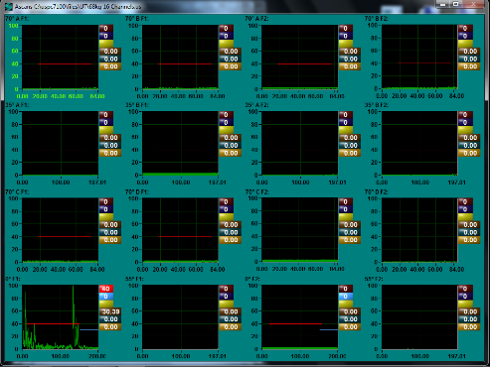
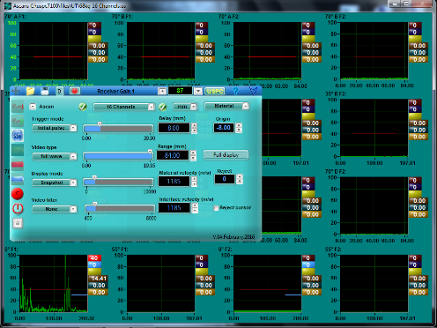
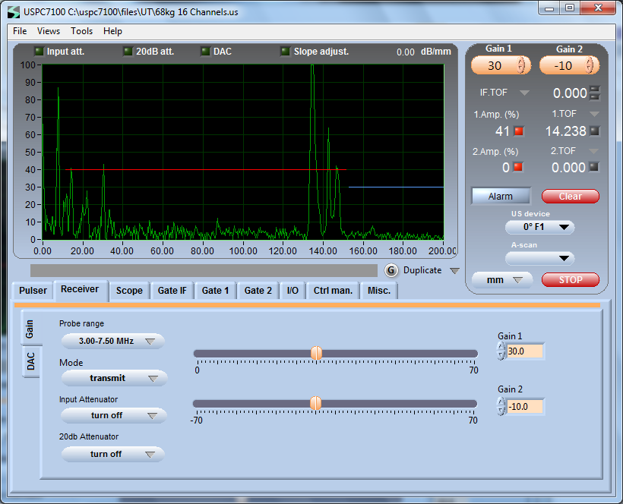
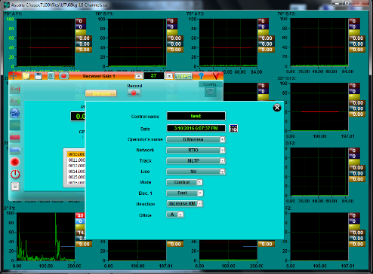
Description of the Acquisition computer
Acquisition computer
Acquisition Software AMS7100
Recording the campaign
Use to parameter the Ultrasound parameters
16 Channels maximum per computer with the possibility to add more in parallel
16 A-Scans display
Settings of acquisition
Advanced Ultrasonic parameters
Start new personalized campaign

Slide 6
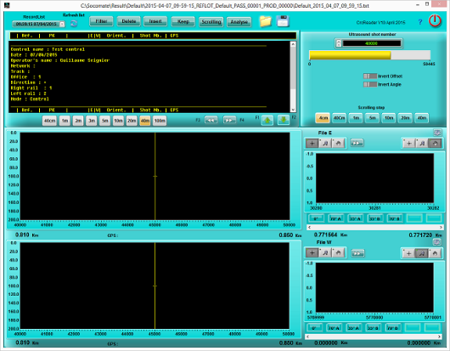
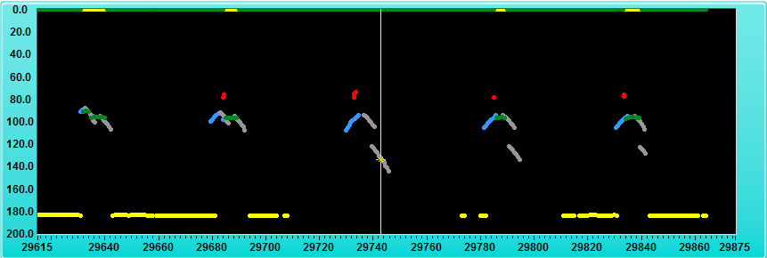
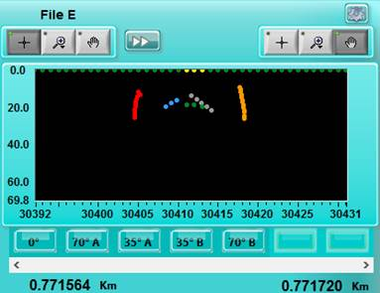
Description of the CrC computer – Measurement system
User Interface
CrC computer:
Analyzing Software for a continuous control of the rail
Analyze the acquisition
Create a complete report of the campaign
Shows the flaw detection within the rail
Indicate the kilometric point from one to many defects
Global analysis of the campagne
If required, creation of a text report and B-Scan imaging to illustrate the defects
Possibility to read datas from external computer
GPS function to have defects localization
B-Scan imaging of the defects
Zoom on the defect to validate

Slide 7
Configuration
Phased Array FAAST – 64 Channels
Conventional UT electronics – Up to 16 per PC
Conventional UT electronics – Up to 16 per PC
3U - 19”
4U - 19”
6U - 19”
Acquisition PC
Acquisition PC
2U - 19”
Acquisition PC
2U - 19”
CrC Software
2U - 19”
CrC Software
2U - 19”
Phased Array combined with conventional UT electronics
UT system using conventional UT electronics

Slide 8

References
Realizations – Installations - Projects

Slide 9
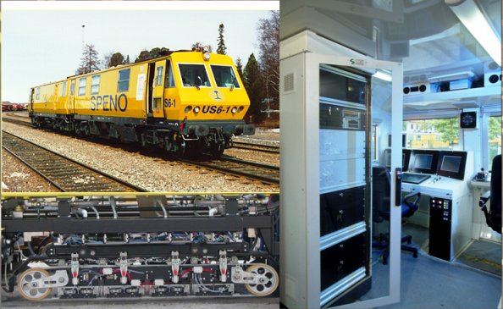
References
High speed railway inspection with our USPC electronic for conventional Flaw detection, with an on-track inspection able to go up to 100km/h.
Socomate International has developed a complete system, electronics and software, to be integrated into inspection vehicle.
Socomate International has equiped more than 20 inspection vehicle according to our conventional UT electronics

Slide 10
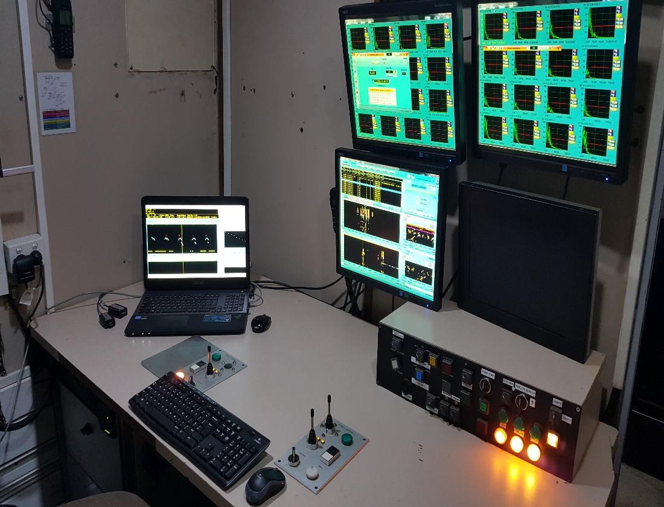
Installations
Speno Rail Maintenance Australia
System using FAAST Phased Array and conventional UT electronics
Multi-angle acquisition using 1D linear probe
72km/h
Inspection pitch: 4mm
8 directions per rail using one 1D linear probe, and 3 conventional for 0°, 55° and 70° offset

Slide 11

Projects
RATP – Project to equip the inspection vehicle of the french Paris metro company with the Phased Array FAAST
Eurailscout – Project to equip their inspection service cars with the Phased Array FAAST combined with conventional.
China – Project with our Partner to develop an inspection vehicle for the chinese market using FAAST technology.
Current evaluation to perform UT inspection at 140km/h
Number of projects are not restricted to the above list. Socomate International would be pleased to supply your inspection vehicle with our patented technology.

Slide 12

Advantages and conclusion
Our UT system benefits of many references that has been in service since many years
Using the Phased Array FAAST would provide an added value to a system such as :
Less probes
High speed inspection
Flexible : Configure or add more direction simply by software settings
Savings : Less mechanics, less water required, less maintenance, less calibration time
Socomate International is customer oriented to always supply the best services to its customers
Benefit a team of expert at your services
Contact us to have a complete demonstration and simulation of the system
Visit us : www.socomate.com
Sales contact : Xavier.harrich@socomate.fr
Thank you

