Slide 1
UT Phased Array inspection for billets and bars
Perform your inspection with an added value.

Slide 2
Summary
Presentation of FAAST technology
UT Bars inspection with multi-angle required
UT Bars inspection with multi-focus required
UT Bars inspection with multi-frequency required
Examples of feasability study on round bar with Multi-angle (A-Scans)
Results Analysis
Get a feasability study on your products with Socomate
Advantages and conclusion

Slide 3
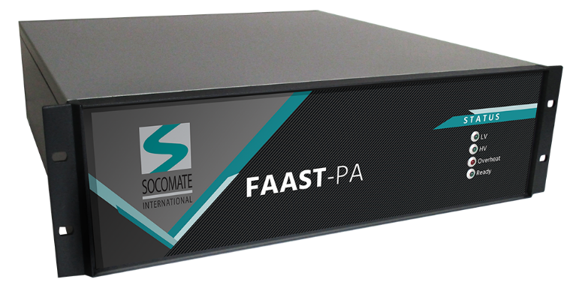
Presentation of FAAST, patented technology
Certified ISO 18563-1 according to Phased Array standard
FAAST-PA is a Phased Array much more powerful than conventional ones. Due to its capacity, it provides high productivity for UT testing lines, with high flexibility.
The product is coming with a full Software Development Kit to supply high possibility regarding application Software.
All parameters, such angles, are configurable through Software settings and is as easy to use as standard product, the only difference is; All beams are generated simultenaously.

Slide 4
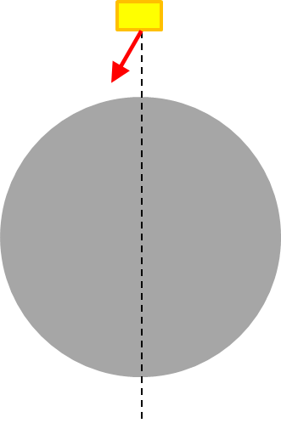
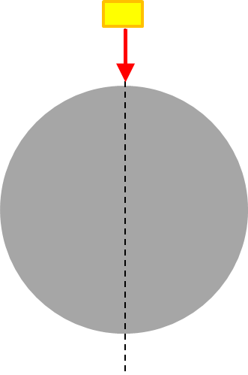
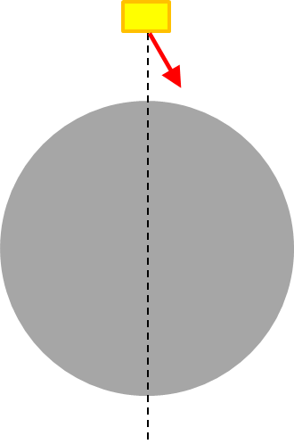
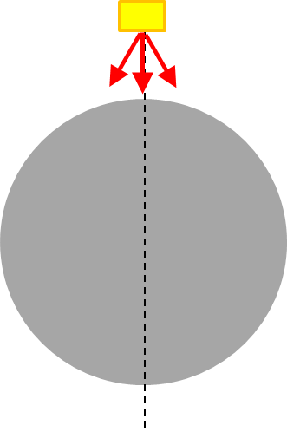
UT bars inspection using Multi-angle
Standard Inspection
UT FAAST Phased Array Multi-angle
PA Probe
PA Probe
Internal flaws (e.g: Inclusion, ….)
Surface defects (e.g: longitudinal and transverse cracks)
+
+
UT FAAST Inspection: ONE SHOT is required for multiple angles using only 1 PA probe, allowing thus to increase inspection speed.
For example, such configuration is 3 times faster than with conventional Phased Array inspection.
This example does not restrict the number of angles
Conventional PA Inspection: Several sequential shots with different angles have to be used, according to inspection needs
Figure 3 : 3 Sequential (one direction) shots

Slide 5
UT bars inspection using Multi-focus
Standard Inspection
UT FAAST Phased Array Multi-focus
PA Probe
PA Probe
Multizone testing using focusing beams
Shot 1
Conventional PA Inspection: Several sequential shots are required, according to the diameter
UT FAAST Inspection: ONE SHOT is required for multiple focused beams
Shot 2
Shot 1
Shot 3

Slide 6
UT bars inspection using Multi-frequency
Standard Inspection
Multi-frequency for 0° inspection
UT FAAST Phased Array Multi-frequency
PA Probe 2MHz
PA Probe 5 MHz
PA Probe – 2MHz and 5MHz in one single shot
Conventional PA Inspection: In the case that several frequencies are required to inspect the product, it is possible to perform the inspection using only 1 PA probe, but with sequential shooting.
In certain case, 2 probes are used to increase the inspection speed.
UT FAAST Inspection: Using only 1 PA probe, FAAST technology allows to send 2, or more, ultrasonic beams at different frequencies in ONE single shot.
For example, multi-frequency has been used for the OCTG reference, with wall thickness measurement at 5MHz and delamination at 7,5MHz in one shot.

Slide 7
Results between conventional PA and FAAST-PA
Performances does not mean a decrease in Quality.

Slide 8
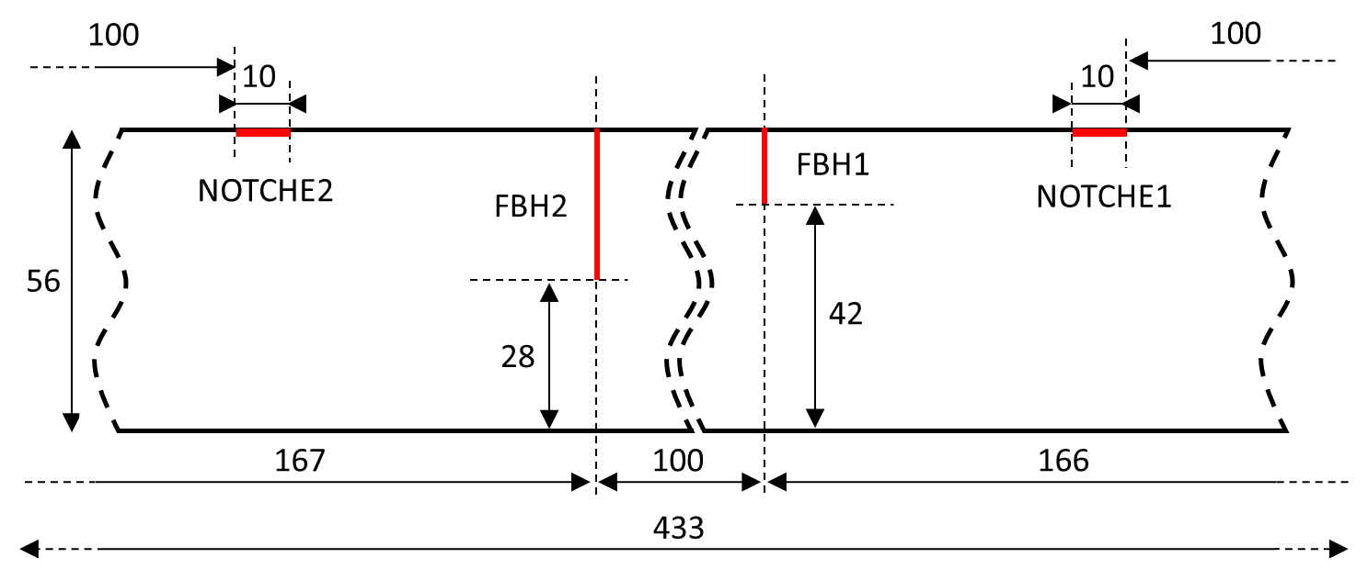
Example of standard round bar inspection
Standard round bar schema (dimensions in mm)

Slide 9
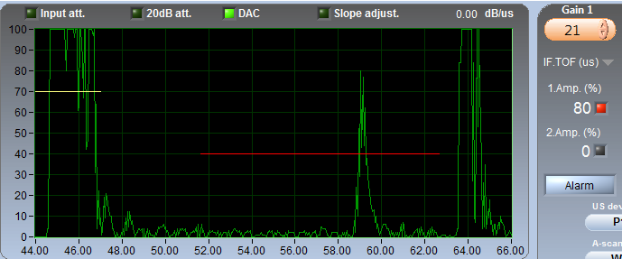
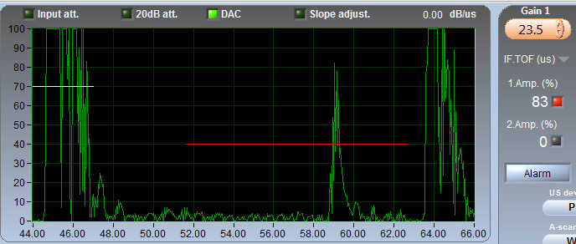
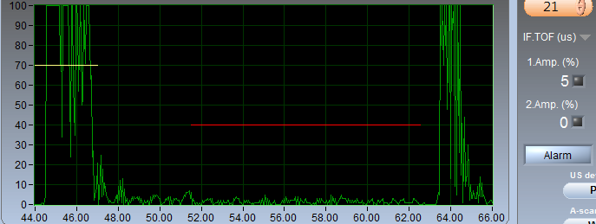
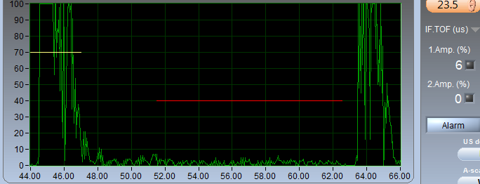
Example of A-Scans – FBH 1 detected with 0° shot
Standard Inspection
UT FAAST Phased Array Multi-angle
SNR=24dB
FBH 1
SNR=22dB
FBH 1
No defect
No Defect
No Defect

Slide 10
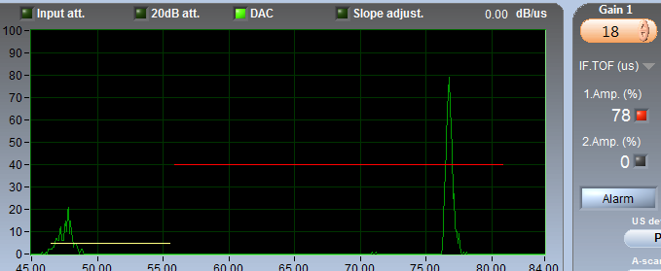
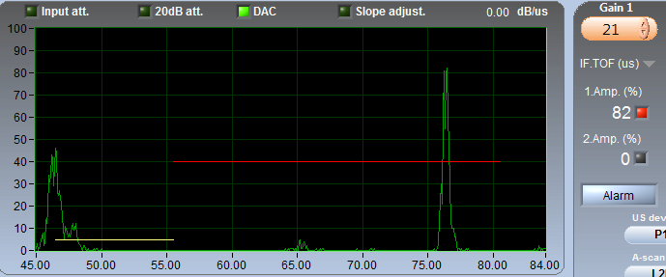
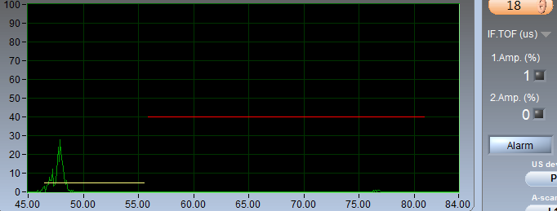
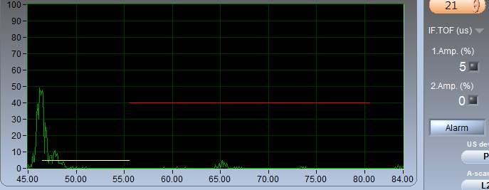
Example of A-Scans – Notche 1 detected with oblique shot
Standard Inspection
UT FAAST Phased Array Multi-angle
SNR=24dB
Notche 1
SNR>28dB
Notche 1
No defect
No defect
Back echo response due to 0° shot

Slide 11
Results Analysis
Flat-bottom Holes detection
Notch 1 (0.1mm depth) detection
We notice that needed gain to obtain flaw response at 80% is practically the same, less than 3dB difference. The results in term of SNR is also very close; SNR=24dB in one directional shot compared to SNR=22dB when 3 directions are combined in transmission (for both FBH).
We can also notice that needed gain to obtain flaw response at 80% is practically the same, less than 3dB difference.
When we use a combined shot and due to the gain needed to detect flaw, we can see as “permanent” noise a back echo of 0° direction shot in the bar. In spite of this, we have a good SNR. At least, we have SNR=24dB in longitudinal CW or CCW reception.

Slide 12
Results Analysis
We have shown that results obtained by mixing the straight shot to the 2 others oblique shots in the FAAST system are satisfying and not so far from those obtained in different sequential shots.
The main goal of this report is to highlight potential possibilities of FAAST system for the bar inspection, particularly the capability to shot in multiple direction, at different frequencies or at different depth, at the same time.

Slide 13
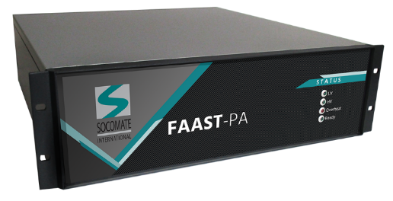
Get a feasability study
FAAST Technology allows high speed UT inspection, as well as lots of flexibility.
Used to equip new lines or retrofitting old electronics
Socomate International provides complete feasability study on your products.
(Number of required channels, Optimal probe, number of elements, sizes, shapes, frequency, …) following your requirements
Worldwide supplier of OEM UT electronics, coming with the most complete & friendly SDK, to customize your own application

Slide 14
Advantages and conclusion
High speed testing coming along with lots of flexibility
A performance that not decrease the quality
A team of experts at your service
Feasability studies on samples in Socomate’s laboratory, or on-site
Reducing the number of required probes and/or mechanics
Ideal for equipping new lines or retrofitting old electronics
Interested or having a project ? Contact us to have a more information
Thank you
Visit us : www.socomate.com
Sales contact : Xavier.harrich@socomate.fr

